Slide 1
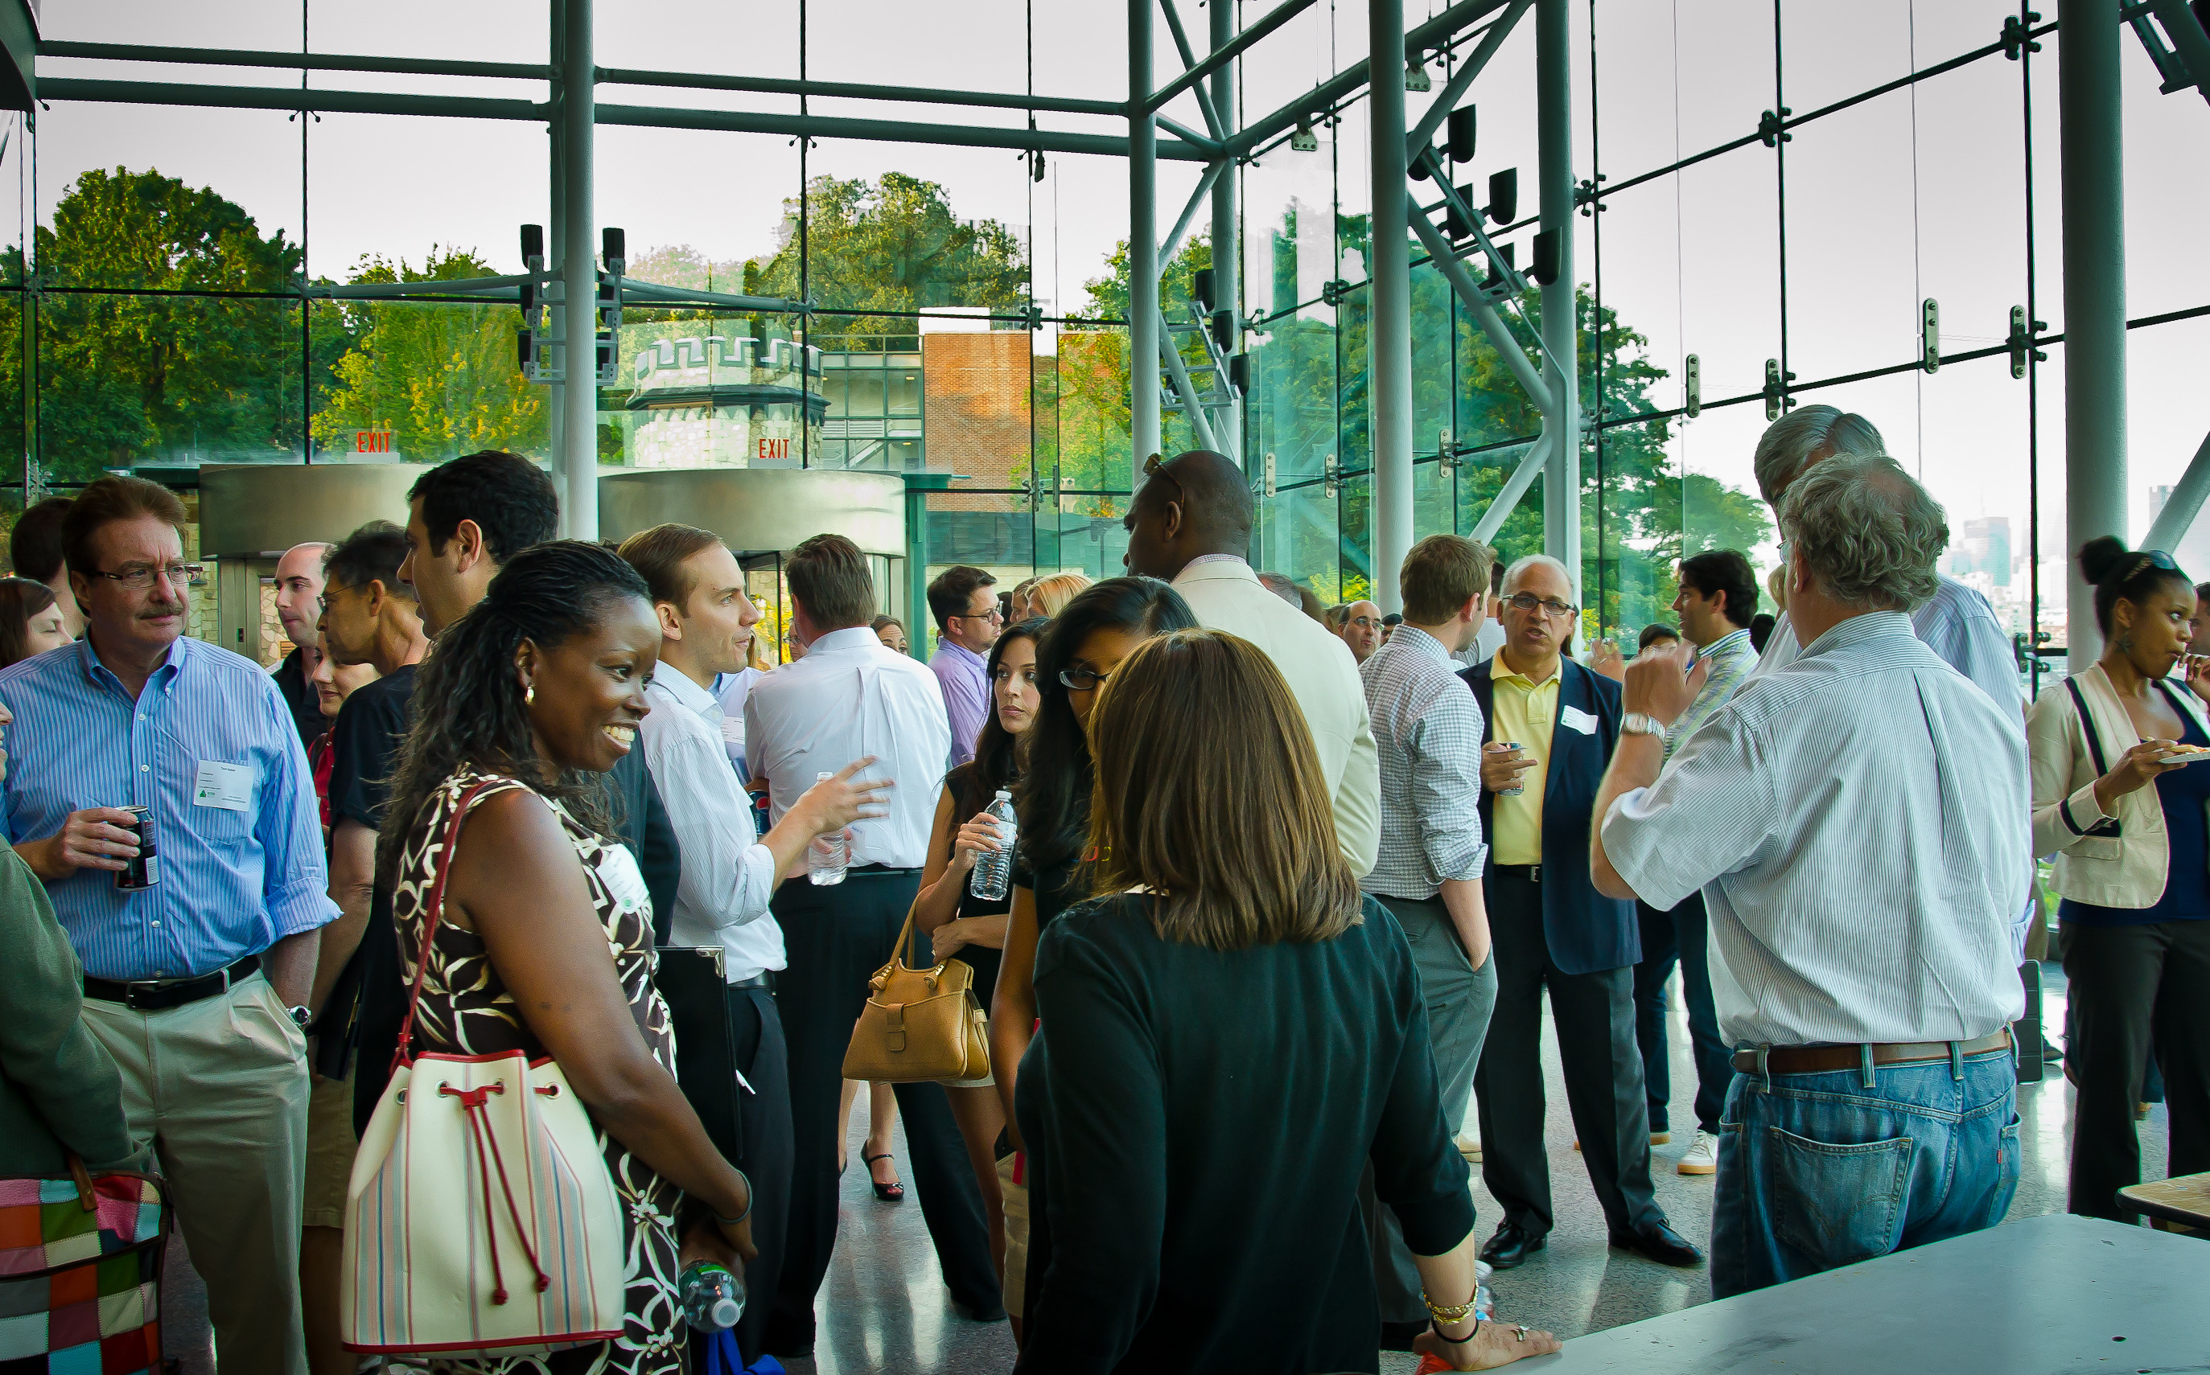
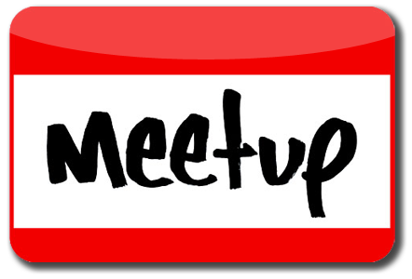


Building Modern Internet scale applications using Micro Services
Topics :
101 on Azure Container Services by Soham, Lead Developer, McKinsey Digital Labs
Title to be added by Milan Mitra, Lead Digital Architect, McKinsey Digital Labs
Build Server-less Architecture with Azure Functions by Ilyas F, Principal Consultant, Xpirit
Azure Service Fabric by Vishnu Rajkumar, Principal Architect at Microland
Where :
McKinsey Digital Labs
NALAPAD BRIGADE CENTRE, Whitefield Road, Mahadevapura, ITPL road, Bengaluru, Karnataka 560048, Bangalore
When:
4th Saturday, Feb 2017 (9.30 am to 1.30 pm)
Powered By
Initiative By : https://www.meetup.com/Microsoft-Azure-Bangalore/

